Slide 1

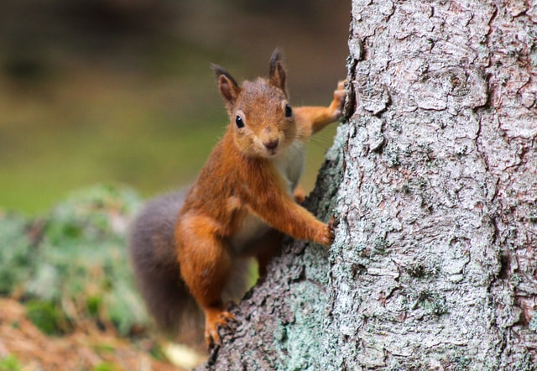
Predicting the Colors of Squirrels in Central Park
By Vanessa Razon

Slide 2
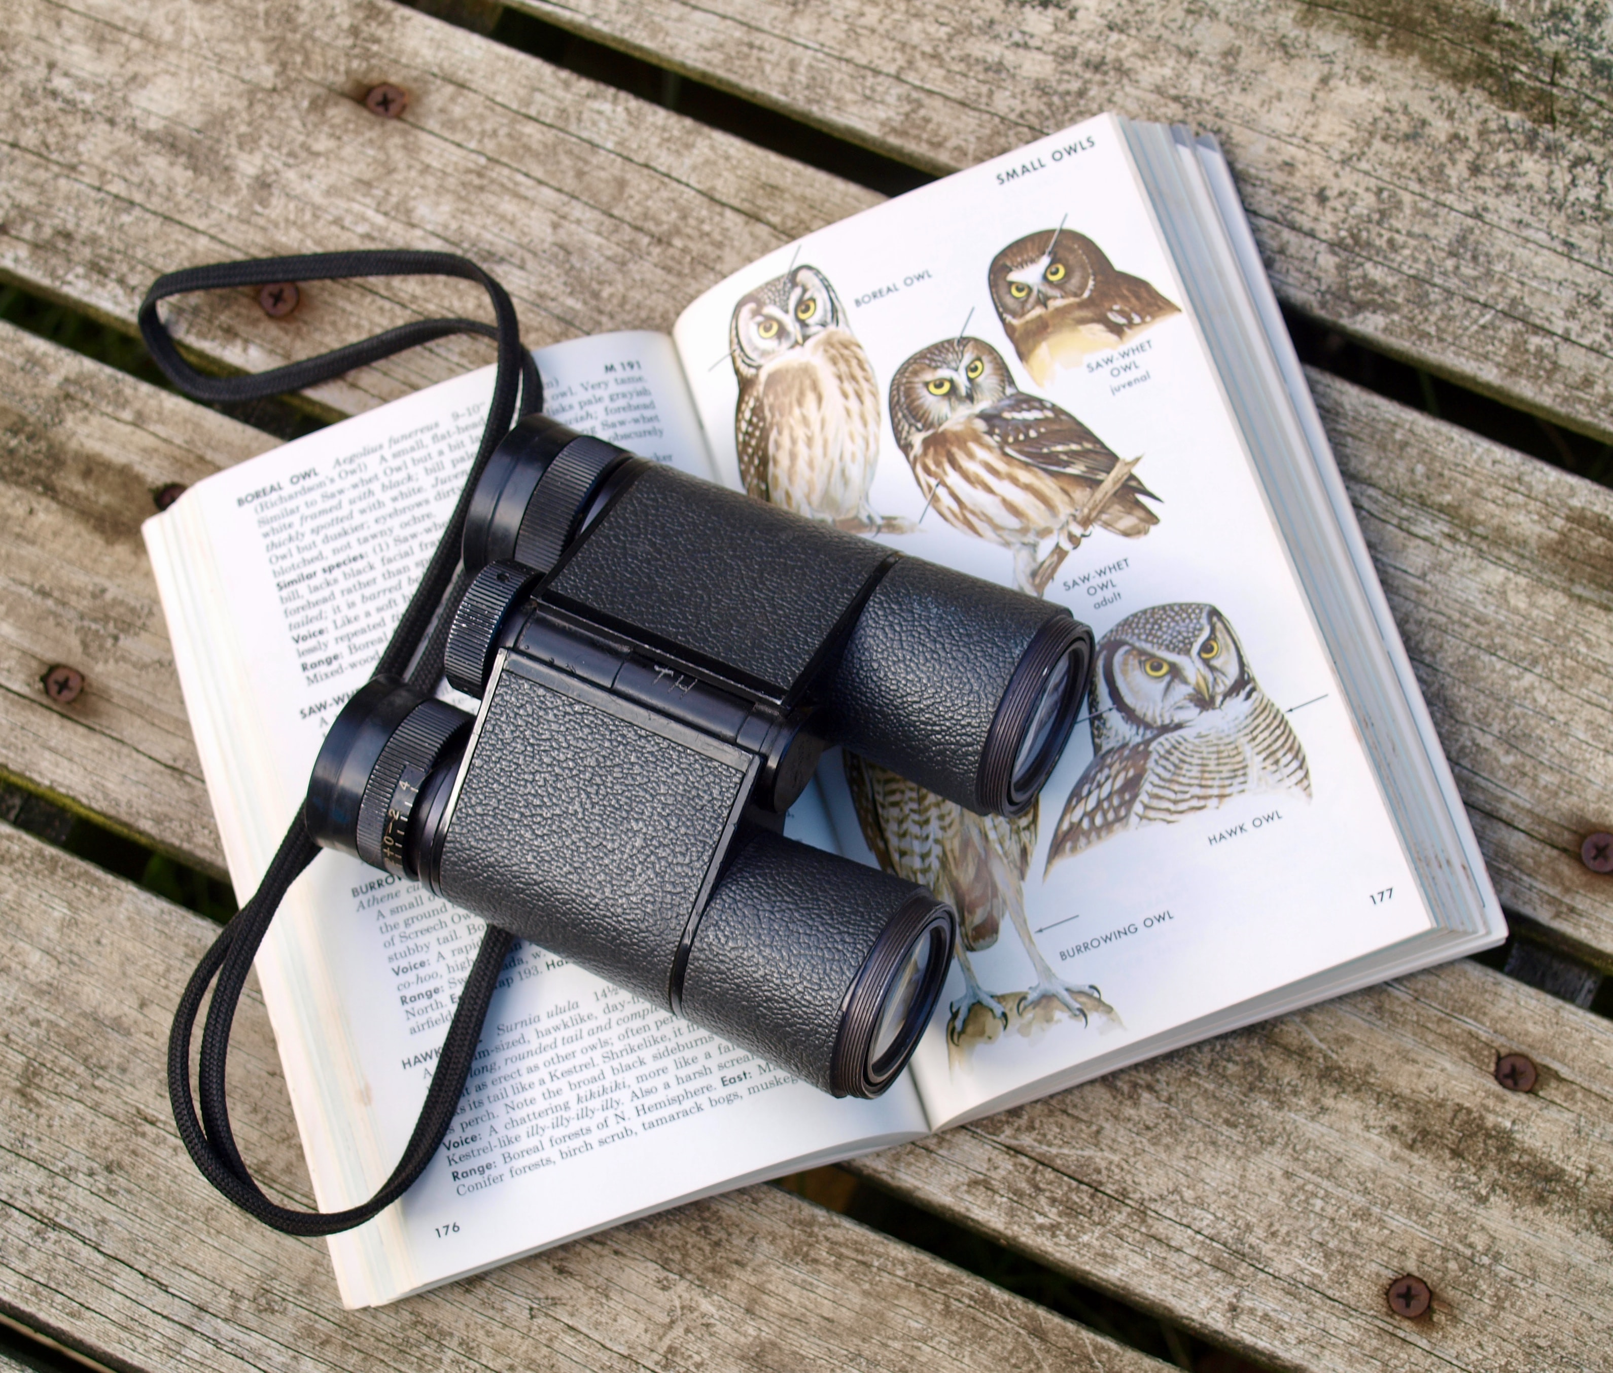
Literature Review
Cornell University

Slide 3
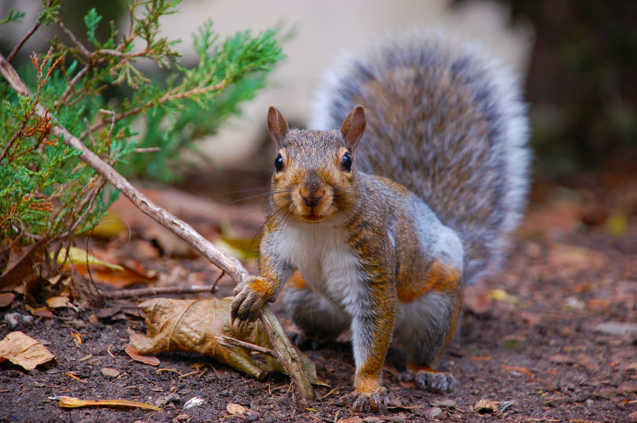
Dataset
Central Park Squirrel Census Data Collected by 323 volunteers on October 2018
3000 observations recorded (2968 used)
Contains information:
data related to space and time
squirrel colors and activities
Amount of data
Reliability of the data

Slide 4
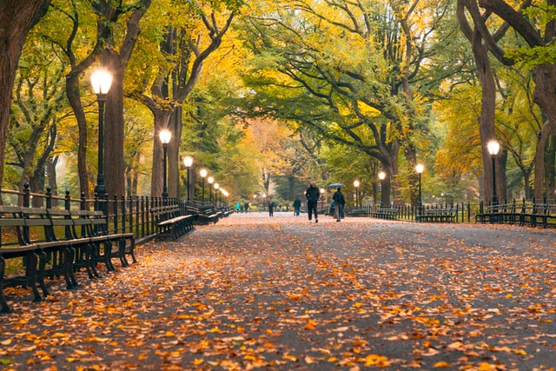

The Goal of the Project
??
??
Multiclass Logistic Regression ?
Multilayer Perceptron ?
Support Vector Machine ?
Decision Tree ?
Random Forest ?
Black?
Location
Time of Day
Date
Gray?
Cinnamon?
White?

Slide 5
The Models
Multiclass Logistic Regression
Multilayer Perceptron
Support Vector Machine
Decision Tree
Random Forest

Slide 6
The Results
 | Accuracy (%)
Model | Predicting Primary Color | Predicting Highlight Color
Multiclass Logistic Regression | 82.07547 | 34.23181
Multilayer Perceptron | 82.07547 | 34.23181
Support Vector Machine | 82.07547 | 34.90566
Decision Tree | 75.33693 | 44.47439
Random Forest | 82.07547 | 34.90566

Slide 7
Imbalance Classes Problem
Most of the models only predicted gray squirrels
Attempts to solve the problem:
Penalized-SVM: accuracy of 38.14016%
Tree-based algorithms
Random forest with 13 estimators

Slide 8
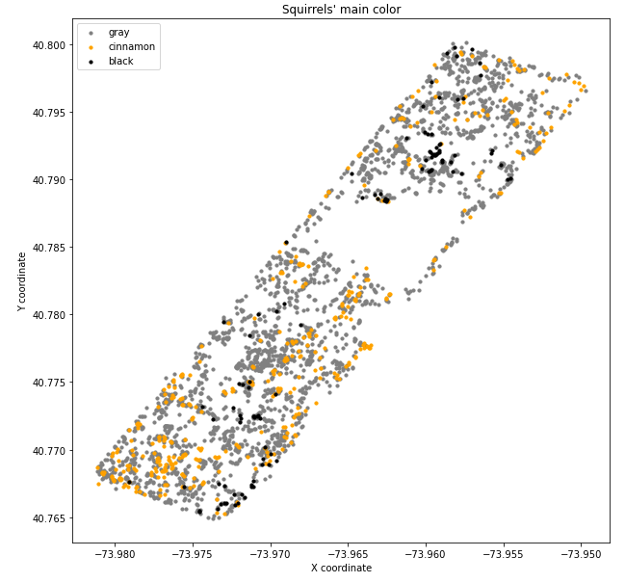
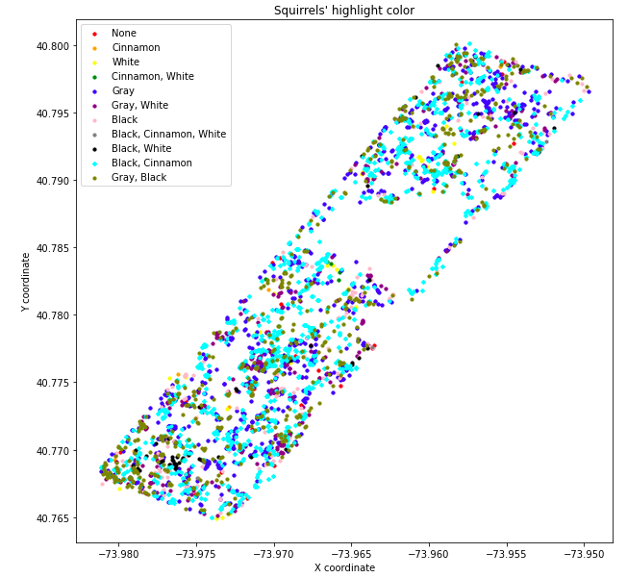
Clustering Approach

Slide 9
The Results
Model | Error (Separate) | Error (Merged)
Multiclass Logistic Regression
Multilayer Perceptron
Support Vector Machine
Decision Tree
Random Forest

Slide 10
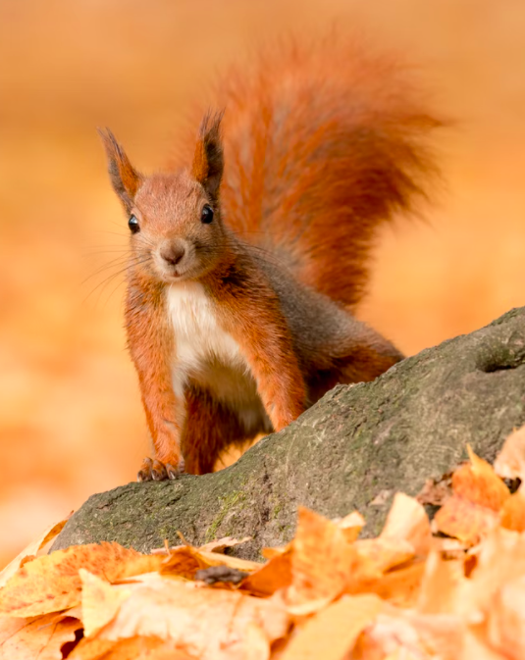
Conclusion

Slide 11
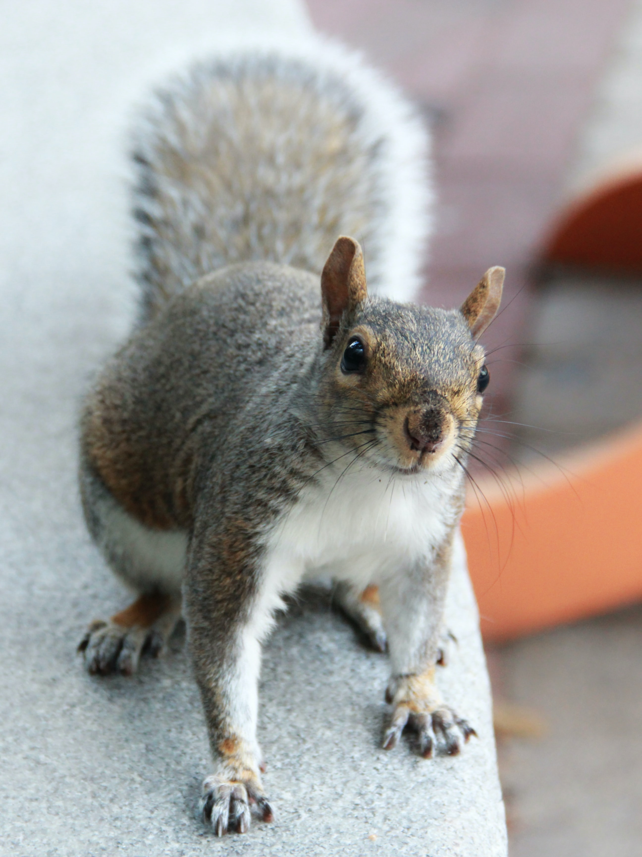
Thank you

